Slide 1
Distribuited Iot Home security system
Author: Dezső László

Slide 2
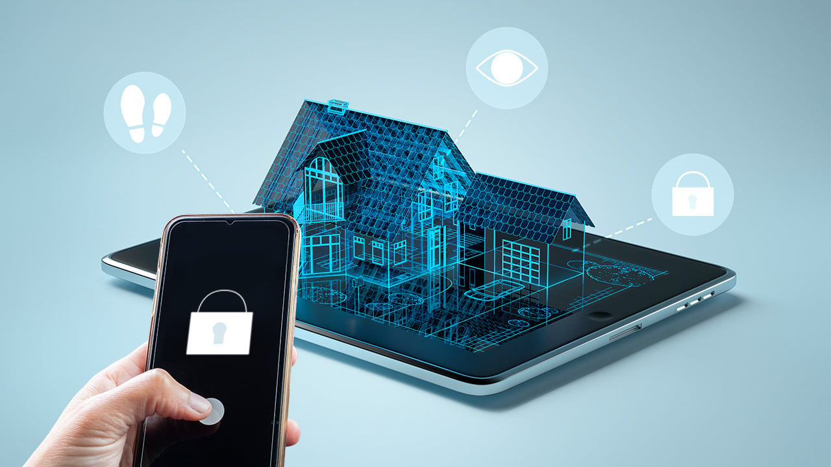
Introduction & Context
Goal: Simulate a scalable "Smart Home" security panel without physical hardware dependencies.
Architecture: Client-Server Model (The core of IoT).
Key Capability: Real-time, bidirectional communication between "Edge Nodes" (Sensors) and
a "Central Gateway" (Dashboard).

Slide 3
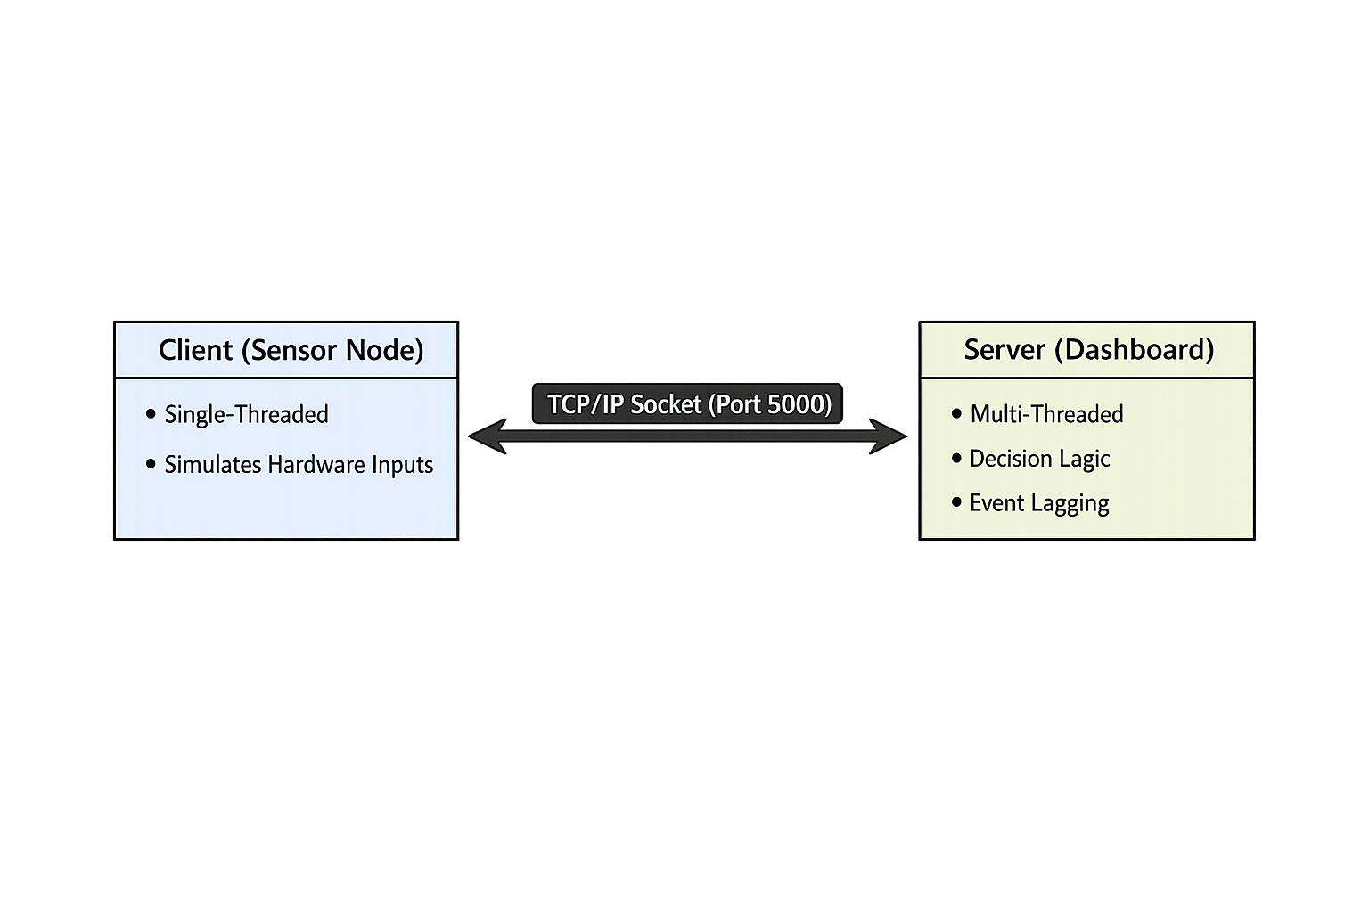
System architecture
The system uses a persistent TCP connection. The Server runs on a separate thread to prevent GUI freezing (blocking), ensuring real-time responsiveness.

Slide 4
Implementation & protocols
Language: Python 3.10
GUI: Tkinter(Native OS integration)
Networking: socket library
Custom Protocol: ASCII-based message parsing
Example Payload: ZONE:Kitchen:OPEN
Security Logic:
IF (Sensor == OPEN) AND (System == Armed):
Trigger_Alarm

Slide 5
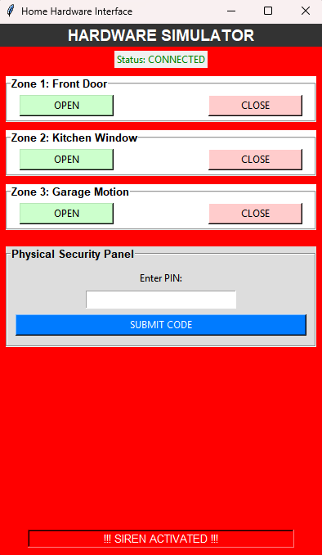
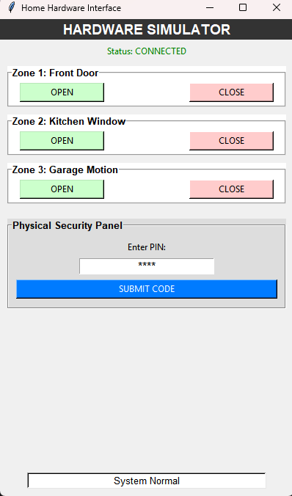
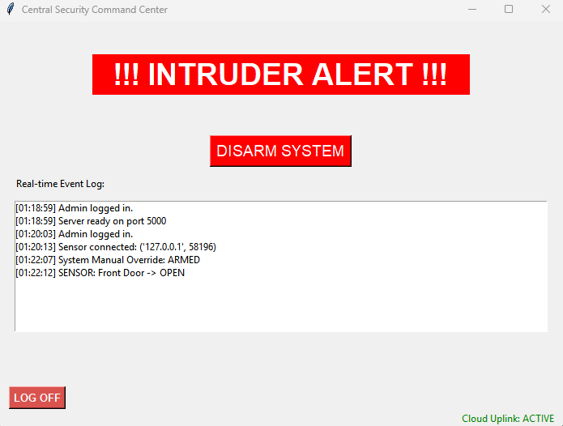
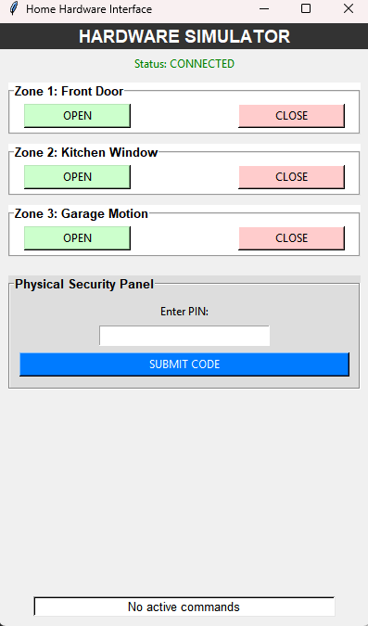
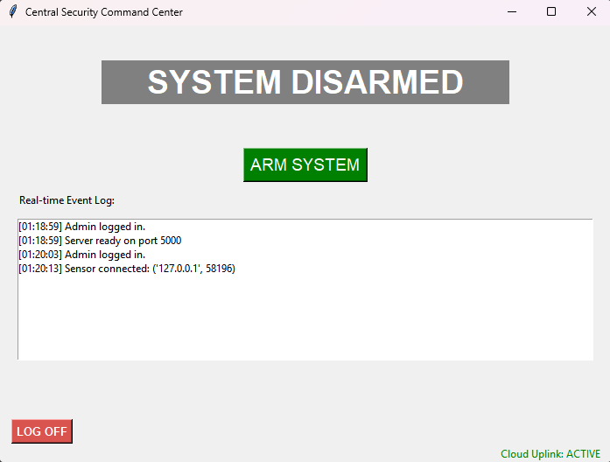
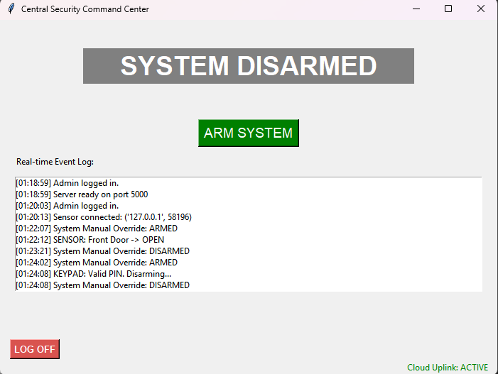
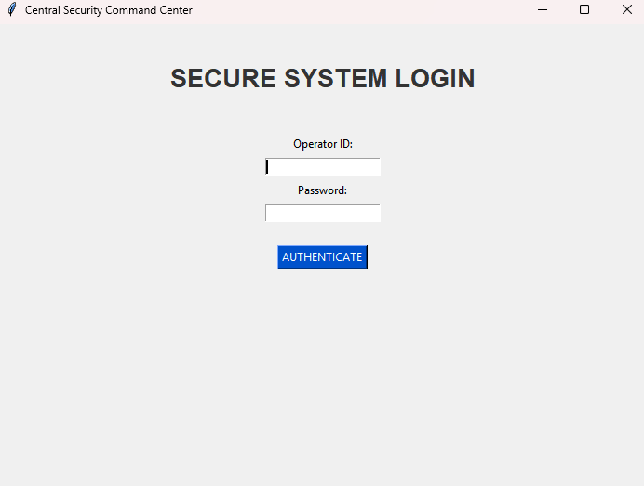
Key features

Slide 6
Demonstration Roadmap
Authentication: Login as Administrator.
Handshake: Connect Sensor Node to Main Server.
Intrusion Test: Arm System -> Trigger Sensor -> Verify Alarm.
Remote Disarm: Use Keypad (PIN: 1234) to reset system.

Slide 7
CONCLUSION
Success: Fully functional TCP/IP simulation meeting all requirements.
Reliability: Auto-reconnect features ensure system stability.
Future Improvements:
Migration to SQL Database for logs.
TLS/SSL Encryption for secure data transmission.
Mobile App Integration (Android/IOS Client).

Slide 8
THANK YOU FOR YOUR ATTENTION!

